Slide 1










Keep
Warm
Team Roshambo

Slide 2



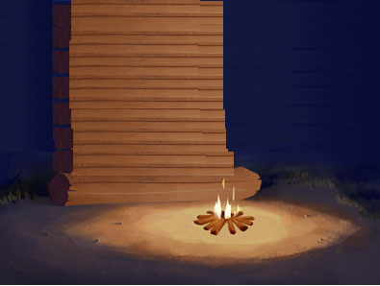





Keep
The Game
Survival
Turn Based
Multiplayer
Warm

Slide 3





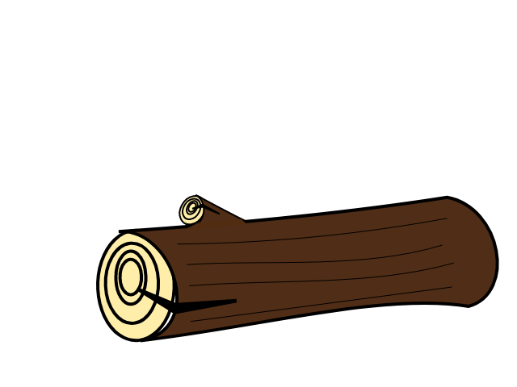
Keep
Best Stuff
Traps
Eating
Fire
Warm

Slide 4
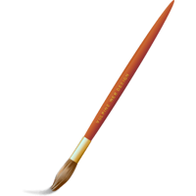

Keep
Style
Fine Canadian Art
Hand Crafted Sfx
Over 5 Songs
Warm

Slide 5
Keep
Finale
Prototype...
?
Warm

